Slide 1
Topic 01 What is Business Intelligence?
ICT394 BI Application
Development

Slide 2
Resources for this topic
Reading:
Obeidat, M., North, M., Richardson, R., Rattanak, V., and North, S., 2015, Business Intelligence Technology, Applications, and Trends, International Management Review, 11(2): 47-56
Videos:
Hitachi Solutions Canada, 2014, What is Business Intelligence (BI)?, https://www.youtube.com/watch?v=hDJdkcdG1iA
Microsoft BI TV, 2009, Business Intelligence Customer Case Study: Premier Bank Card, https://www.youtube.com/watch?v=ritRCFcyaLw

Slide 3
Learning Outcomes
At the completion of this topic, you should be able to:
Provide and discuss a working definition of BI
Explain a variety of reasons as to why BI exists
Provide an overview of BI in terms of data, analysis and presentation
This topic contributes to the following unit learning outcomes:
Demonstrate an understanding of the role of BI in organisations
Describe the common data sources that exist in organisations and their use in BI

Slide 4
What do you need to do for this topic?
Readings
Case Study Videos
Lecture Slides/Recordings
Tutorial Questions
Workshop
End of Topic Quiz

Slide 5
Lecture Outline
Introduction
What is BI?
Why does BI exist?
Data, Analysis and Presentation
Conclusion

Slide 6
ICT394 Business Intelligence Application Development
Topic 01: Part 02
What is Business Intelligence?

Slide 7
What is Business Intelligence?
Perhaps a better question is, “What isn’t it?”
It is not a single technology
It is not an application
It is not a methodology
It isn’t about spying on competitors
It IS an often-used, but poorly understood term

Slide 8
There are many definitions…
They range from simplistic
Rud (2009) states that it is, “…a term that encompasses all the capabilities required to turn data into intelligence” (p. 3)
To functional…
Langit (2007) citing Microsoft, states that BI is “…a method of storing and presenting key enterprise data so that anyone in your company can quickly and easily ask questions of accurate and timely data.” (p. 1)
Rud (2009) “…getting the right information to the right people at the right time through the right channel” (p. 3)

Slide 9
More definitions…
Williams & Williams (2006) suggest that BI is a combination of products, technologies and methods
This combination leads to better organisation of key organisational data for improved decision making, that drive (for example):
Increased sales, reduced costs and increased profits

Slide 10
What does it do?
It helps decision makers to:
Answer questions such as:
“How well are the various parts of the organisation performing?”
“Into which market segments do my customers fall, and what are their characteristics?”
“How can I tell which transactions are likely to be fraudulent?”
Better manage the organisation
Conform with government regulation

Slide 11
So what is BI?
BI is an organisational outcome, or set of outcomes
…based on the combination of
Data
Analysis
Presentation
…that involve the provision of information to the users who need it, in a form that is useful to them, in a timely fashion

Slide 12
ICT394 Business Intelligence Application Development
Topic 01: Part 03
Why does BI exist?

Slide 13
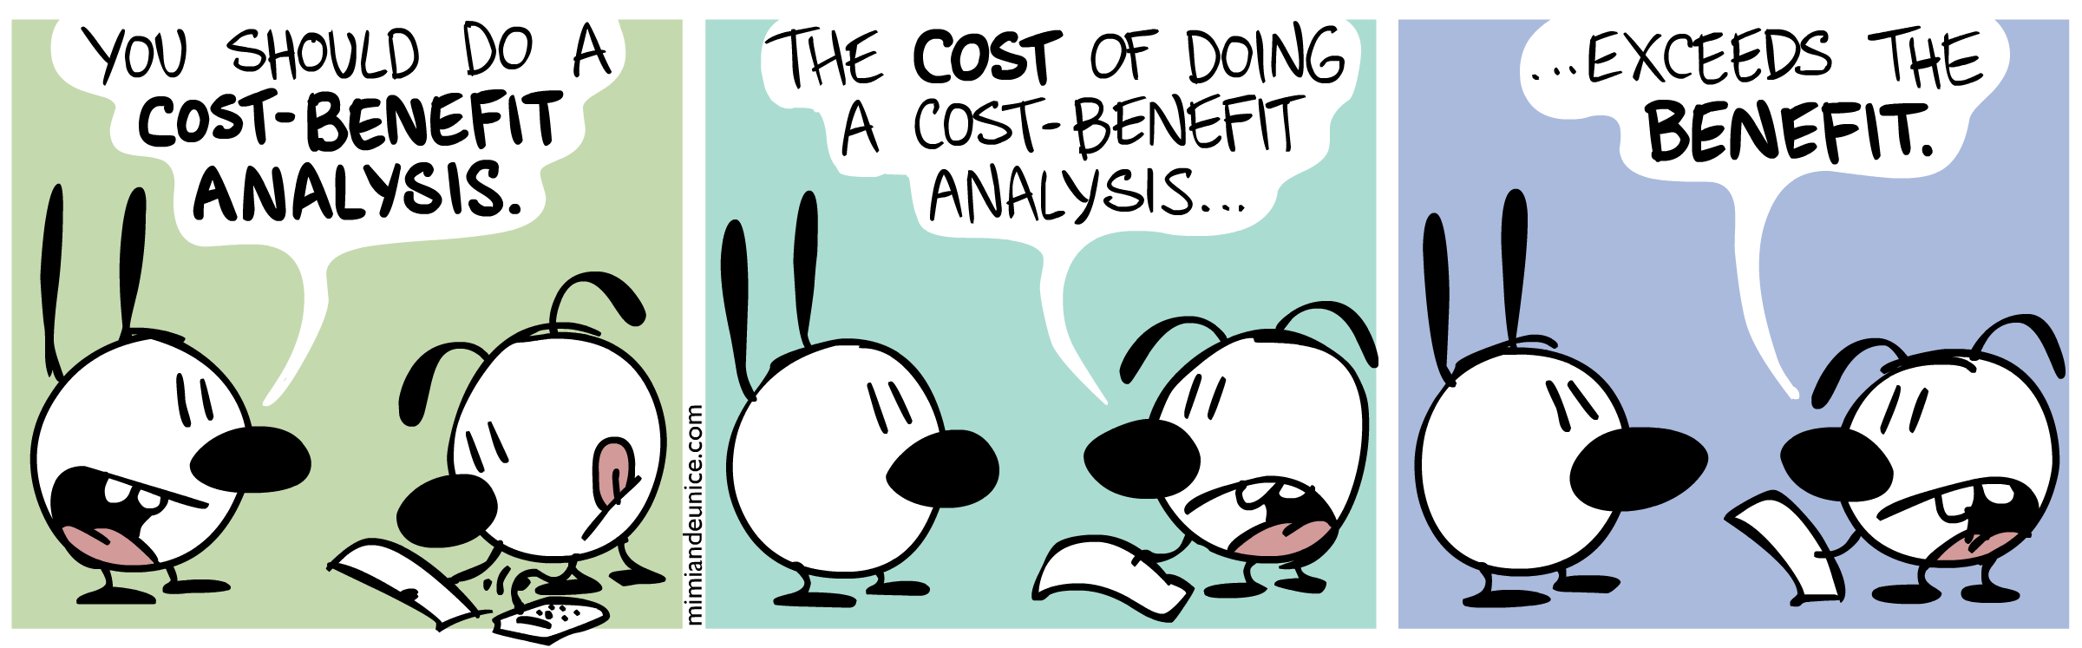
Why does BI exist?
In order to understand this question, we need to understand the costs, the benefits and the facilitators for organisational BI
http://mimiandeunice.com/wp-content/uploads/2011/08/ME_384_CostBenefit.png

Slide 14
Costs of BI
BI is expensive to implement
Dedicated resources
Hardware, human
Disruptive
Design and implementation is non-trivial
Time consuming
Not a great history of success!

Slide 15
Critical Success Factors
The literature points to a number of CSF’s for BI implementation:
They suggest factors such as:
Committed management support
Clear vision and well-established business case
User-oriented change management
Successful data quality and integrity
(Yeoh & Popovic, 2016)

Slide 16
Benefits of BI
Many are claimed!
Most centre around improved decision making and the gaining of “insights”
Often manifested as:
Improved forecasting
Improved processes
Improved data governance
Empowerment of decision makers

Slide 17
BI is facilitated by
Improvements in technology
…and reduction in costs of storage/processing
Improvements in analytics and visualisation tools
Improved understanding of the value of data
Me too!
BI successes tend to be reported more than the failures

Slide 18
Data, Analysis, Presentation
In the next lecture, we’ll examine these three aspects of BI…

Slide 19
ICT394 Business Intelligence Application Development
Topic 01: Part 04
Data, Analysis and Presentation

Slide 20
Data, Analysis and Presentation
These are the three primary components/activities of BI
This lecture is an introduction to each of them
The rest of the unit is basically divided between them

Slide 21
Data
From your previous studies, you are aware that database is a collection or set of facts about something of interest
Data is the “stuff” that is stored in the database
In terms of BI, two things happen to data:
Firstly, it is collected, and
Secondly, it is prepared for Analysis

Slide 22
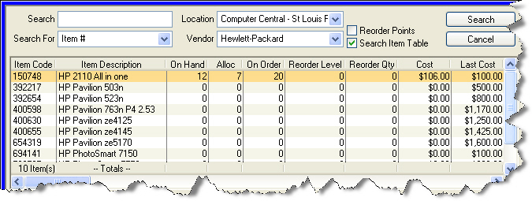
Data Collection
In previous studies, the focus was on data that came from transactions:
Enrolments
Purchases
Orders
This type of data is thought of as being structured
BI makes much use of this type of data
A challenge for BI is identifying these data sources in the organisation

Slide 23
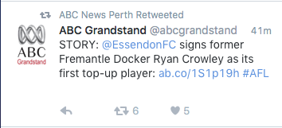
Data Collection
There are other types of data that are not structured (semi- or un-structured) data
Emails
Social media postings
Help desk calls
…are examples of data with less structure
Organisations are increasingly realising the value of these data
QANTAS social media fail

Slide 24


Slide 25

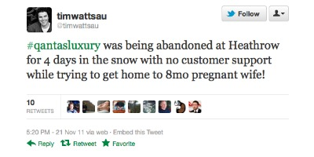
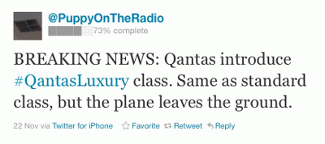

Slide 26
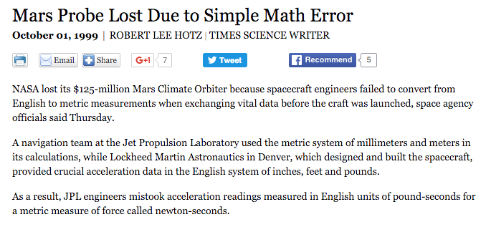
Data Preparation
Identification and collection of data is a start
The data need to be in a format suitable for analysis…
Formats
Names
http://articles.latimes.com/1999/oct/01/news/mn-17288

Slide 27
Data Preparation
There are three main phases in data preparation:
Extract from sources
Transform into a format suitable for analysis
Load into the analysis environment

Slide 28
Analysis
Analysis of data in BI is where the “insights” are generated
Data can be:
Summarised
Aggregated
Joined with other data
In later topics, we will look at OLAP and statistical analyses

Slide 29
Presentation
…and this is where the analysis ends up
End users having access (hopefully) to the information they need!
Presentation is more than simply graphs and tables
There is a developing science around data visualisation
We will just touch the surface of this!
http://www.axiis.org/examples/BrowserMarketShare.html

